Slide 1
L12. Bandit Problem

Slide 2


Introduction
Learning by taking action
Take action, observe reward, infer environment(system) behavior and take a better action
Agent
Action $a$
Environment
(system)
reward $r$
Two types of feedbacks can be used to infer environment (system)
Evaluative feedback – how good the action taken is
Basis of reinforcement learning
Require extensive search among the alternative actions
Instructive feedback – indicates the correct action to taken
Basis of supervised learning
Independent of the action taken, whatever action taken, it will be revealed the right one should have been
Search over a parameter space
Before discussing Reinforcement learning, we first study the evaluative aspect of reinforcement learning in a simplified setting

Slide 3
From Bandit to Reinforcement Learning
Model is unknown
No state dynamic
State dynamic
(action affect state transition and future reward)
Optimum
action
Single state
(non-associative)
Bandit
-
Optimum
policy
Multiple state
(associative)
Contextual Bandit
Reinforcement learning
Contextual Bandit (associative search task) is intermediate between the $n$-armed bandit problem and full reinforcement learning problem

Slide 4
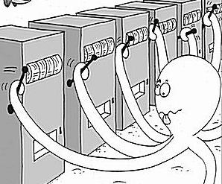

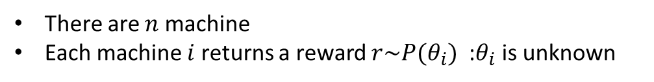

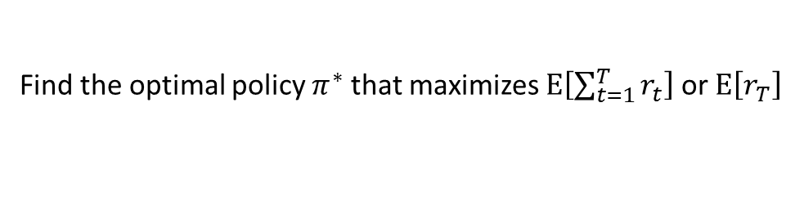
An $n$-Armed Bandit Problem
There are $n$ machine
Each machine $i$ returns a reward $r\sim P(θ_{i})$ :$θ_{i}$ is unknown
$a_{t}∈\{1,…,n\}$ : the choice of machine at time $t$
$r_{t}$ : the reward at time $t$
Policy $π$ maps all the history to new action:
$$π: \left[\left(a_{1},r_{1}\right), \left(a_{2},r_{2}\right),…, \left(a_{t−1},r_{t−1}\right)\right]→a_{t}$$
Find the optimal policy $π^{∗}$ that maximizes $E\left[\sum_{t=1}^{T}{r_{t}}\right]$ or $E\left[r_{T}\right]$
Acquiring new information
(exploration)
capitalizing on the information
available so far
(exploitation)
trade-off
Internet add : Advertising showing strategy for users
Finance : Portfolio optimization under unknown return profiles (risk vs mean profit)
Health care : Choosing the best treatment among alternatives
Internet shopping : Choosing the optimum price (sales v.s. profits)
Experiment design : Sequential experimental design (or sequential simulation parameter)

Slide 5
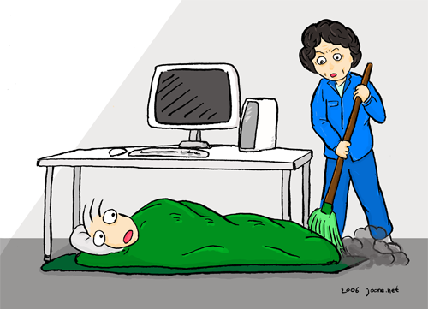

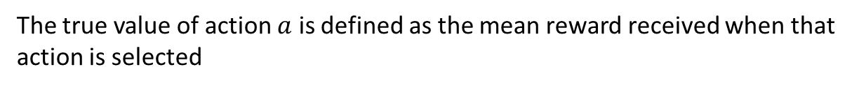


An $n$-Armed Bandit Problem
The value of the action $Q^{∗}(a)$:
The true value of action $a$ is defined as the mean reward received when that action is selected
$$Q^{∗}\left(a\right)=E\left[r\right]$$
At any time there will be at least one action whose value of the action is the largest
Select greedy action (Exploiting): the action with the largest value of action
Select non-greedy action (Exploring): the action enabling you to improve your estimate of the non-greedy actions’ value
Exploiting
Exploring
Go to a company to make money
right after undergraduate
Go to a graduate school to explore my intellectual capability?
How to balance between exploitation and exploration ?

Slide 6


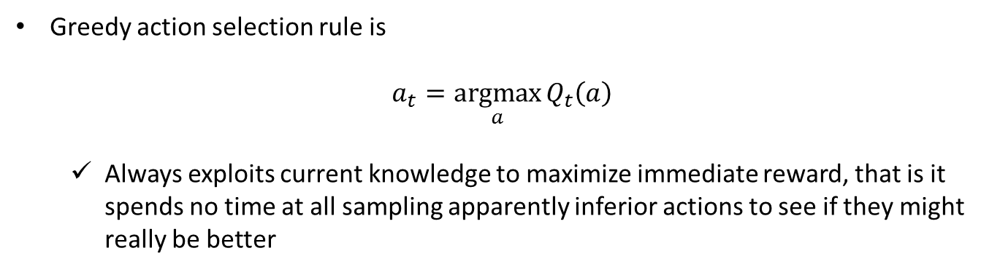
Action-Value Methods
Action-value method estimates the value of an action and use this to select the action
Natural way to estimate the action-value is by averaging the rewards actually received wen the action was selected
If at time $t$, action $a$ has been chosen $k_{a}$ times prior to $t$, yielding rewards, $r_{1}, r_{2}, …,r_{k_{a}}$, the estimated action value $Q_{t}\left(a\right)$ for $a$ at time $t$is defied as
$$Q_{t}\left(a\right)=\frac{r_{1}+r_{2}+⋯+r_{k_{a}}}{k_{a}}$$
If $k_{a}=0$, $Q_{t}\left(a\right)=0$
If $k_{a}=∞$, $Q_{t}\left(a\right)→Q^{∗}(a)$
Greedy action selection rule is
$$a_{t}=\underset{a}{argmax}{Q_{t}\left(a\right)}$$
Always exploits current knowledge to maximize immediate reward, that is it spends no time at all sampling apparently inferior actions to see if they might really be better

Slide 7


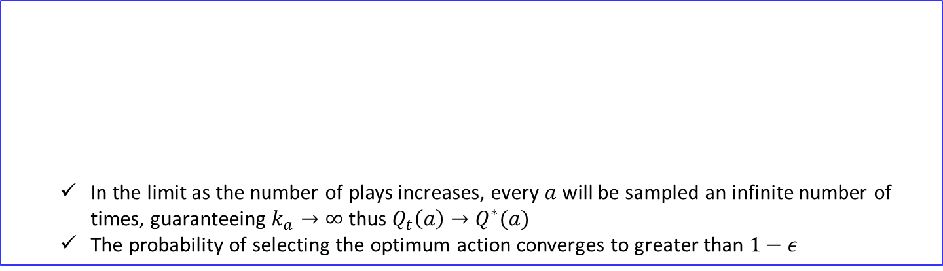



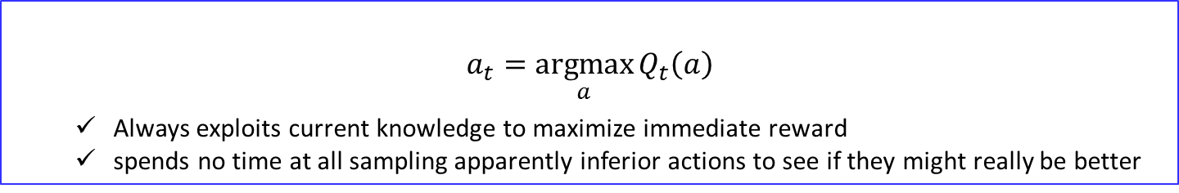


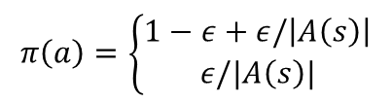
Action-Value Methods
If at $t$th play, action $a$ has been chosen $k_{a}$ times prior to $t$, yielding rewards, $r_{1}, r_{2}, …,r_{k_{a}}$, the estimated action value for $a$ is defied as
$$Q_{t}\left(a\right)=\frac{r_{1}+r_{2}+⋯+r_{k_{a}}}{k_{a}}$$
If $k_{a}=0$, $Q_{t}\left(a\right)=0$
If $k_{a}=∞$, $Q_{t}\left(a\right)→Q^{∗}(a)$
$greedy$ action selection rule
$$a_{t}=\underset{a}{argmax}{Q_{t}\left(a\right)}$$
Always exploits current knowledge to maximize immediate reward
spends no time at all sampling apparently inferior actions to see if they might really be better
$ε−greedy$ action selection rule
In the limit as the number of plays increases, every $a$ will be sampled an infinite number of times, guaranteeing $k_{a}→∞$ thus $Q_{t}\left(a\right)→Q^{∗}(a)$
The probability of selecting the optimum action converges to greater than $1−ε$
$$π\left(a\right)=\left\{\begin{aligned}1−ε+ε/\left|A\left(s\right)\right| \\ ε/|A\left(s\right)|\end{aligned}\right.$$
If $a=a∗$
If $a≠a∗$
$$\left(1−ε+\frac{ε}{\left|A\left(s\right)\right|}\right)×1+\frac{ε}{\left|A\left(s\right)\right|}\left(\left|A\left(s\right)\right|−1\right)=1$$

Slide 8
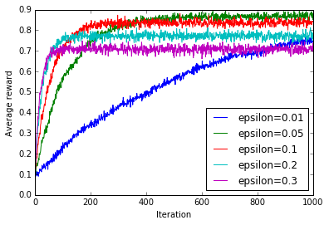
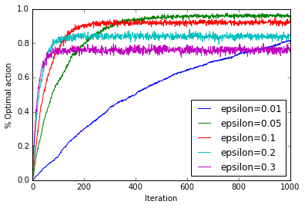


Action-Value Methods
Average reward $E\left[r_{t}\right]$
% of selecting $a^{∗}$

Slide 9




Action-Value Methods
Obtaining the performance curve
Iteration (time horizon)
Simulation 1 : $r_{1}, r_{2},{ r}_{3}, { r}_{4},{ r}_{5}, …, r_{t}^{(1)} ,…,{ r}_{T−2},{ r}_{T−1}, { r}_{T}$
Simulation 2 : $r_{1}, r_{2},{ r}_{3}, { r}_{4},{ r}_{5}, …, r_{t}^{(2)} ,…,{ r}_{T−2},{ r}_{T−1}, { r}_{T}$
$$…$$
Simulation
Simulation 4 : $r_{1}, r_{2},{ r}_{3}, { r}_{4},{ r}_{5}, …, r_{t}^{(i)} ,…,{ r}_{T−2},{ r}_{T−1}, { r}_{T}$
$$…$$
Simulation $N$ : $r_{1}, r_{2},{ r}_{3}, { r}_{4},{ r}_{5}, …, r_{t}^{(N)} ,…,{ r}_{T−2},{ r}_{T−1}, { r}_{T}$
$$E\left[r_{t}\right]=\frac{1}{N}Σ_{i=1}^{N}r_{t}^{(i)}$$
$$\% of{ a}^{∗}=\frac{Σ_{i=1}^{N}1\left\{a_{t}^{i}=a^{∗}\right\}}{N}$$

Slide 10
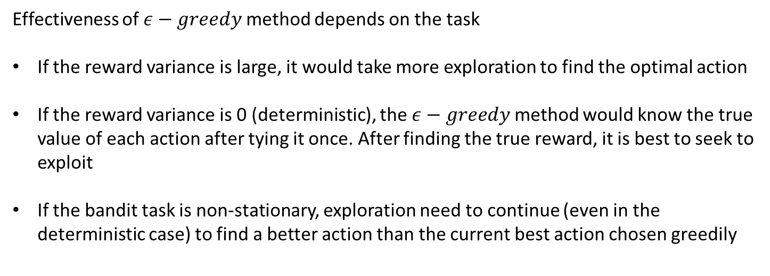
Action-Value Methods
Effectiveness of $ε−greedy$ method depends on the task
If the reward variance is large, it would take more exploration to find the optimal action
If the reward variance is 0 (deterministic), the $ε−greedy$ method would know the true value of each action after tying it once. After finding the true reward, it is best to seek to exploit
If the bandit task is non-stationary, exploration need to continue (even in the deterministic case) to find a better action than the current best action chosen greedily

Slide 11






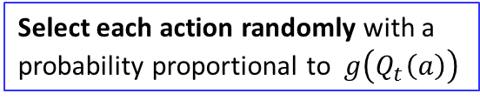
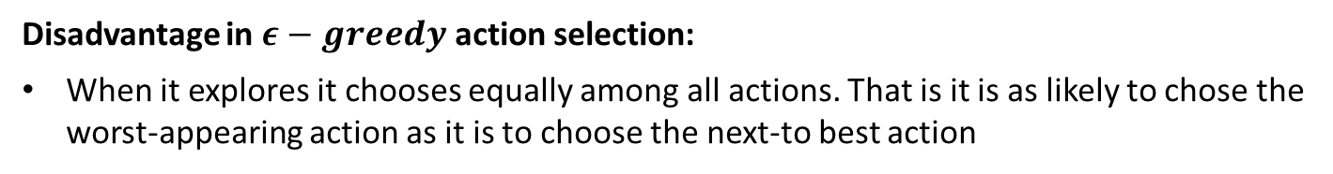









Softmax Action Selection
Disadvantage in $ε−greedy$ action selection:
When it explores it chooses equally among all actions. That is it is as likely to chose the worst-appearing action as it is to choose the next-to best action
Solution:
Vary the action probabilities as a graded function of estimated value
The greedy action is still given the highest selection probability, but all the others are ranked and weighted according to their values estimates
Select each action randomly with a probability proportional to $g\left(Q_{t}\left(a\right)\right)$
$$Q_{t}(a)$$
$a_{t}=\underset{a}{argmax}{Q_{t}\left(a\right)}$ with $p=1−ε$
$$Q_{t}(a)$$
Select randomly with $p=ε/|A\left(s\right)|$
Equal prob.
different prob.
$$a^{0}$$
$$a^{1}$$
$$a^{2}$$
$$a^{3}$$
$$a^{4}$$
$$a^{0}$$
$$a^{1}$$
$$a^{2}$$
$$a^{3}$$
$$a^{4}$$
$ε−greedy$ method
Soft max method

Slide 12
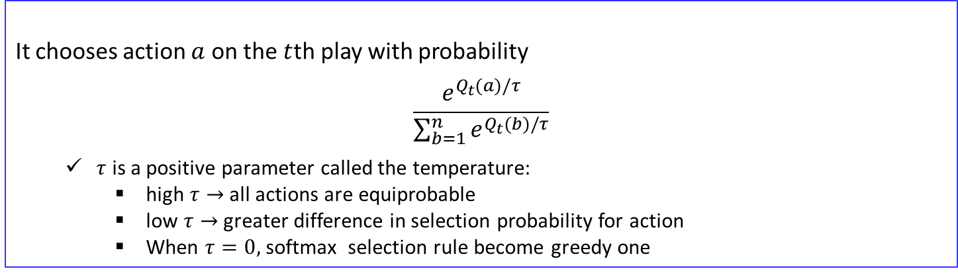
Softmax Action Selection
Disadvantage in $ε−greedy$ action selection:
When it explores it chooses equally among all actions. That is it is as likely to chose the worst-appearing action as it is to choose the next-to best action
Solution:
Vary the action probabilities as a graded function of estimated value
The greedy action is still given the highest selection probability, but all the others are ranked and weighted according to their values estimates
Softmax action selection rule
It chooses action $a$ on the $t$th play with probability
$$\frac{e^{Q_{t}(a)/τ}}{\sum_{b=1}^{n}{e^{Q_{t}(b)/τ}}}$$
$τ$ is a positive parameter called the temperature:
high $τ→$ all actions are equiprobable
low $τ→$ greater difference in selection probability for action
When $τ=0,$ softmax selection rule become greedy one
Whether softmax action selection or greedy action selection rule is better is unclear and may depend on the task and on human factors (i.e., setting $τ$ and $ε)$

Slide 13
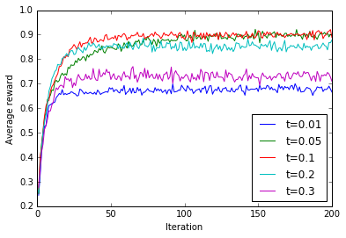
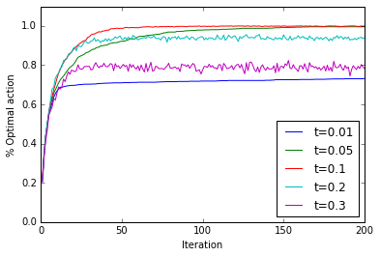
Softmax Action Selection Example

Slide 14
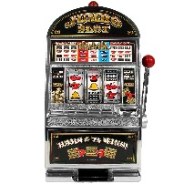
Evaluative vs. Instructive feedback
When I pulled No. 3,
Evaluative feedback say “you earn 1$”
Correctness is a relative property of actions that can be determined only by trying them all and comparing their rewards
Instructive feedback say “The best machine is No.2”
No need to try variety of actions
Condensed information
Regardless of the action chosen

Slide 15

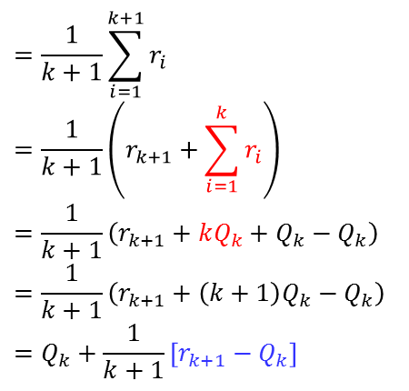

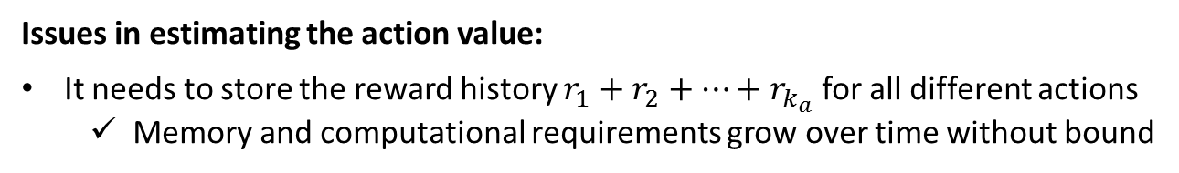
Incremental Implementation
At $t$th play, action $a$ has been chosen $k_{a}$ times prior to $t$, yielding rewards, $r_{1}, r_{2}, …,r_{k_{a}}$, the estimated action value for $a$ is defied as
$Q_{t}(a)=\frac{r_{1}+r_{2}+⋯+r_{k_{a}}}{k_{a}}$
Issues in estimating the action value:
It needs to store the reward history $r_{1}+r_{2}+⋯+r_{k_{a}}$ for all different actions
Memory and computational requirements grow over time without bound
Incremental Update formula
$$=\frac{1}{k+1}\sum_{i=1}^{k+1}{r_{i}}$$
$$=\frac{1}{k+1}\left(r_{k+1}+\sum_{i=1}^{k}{r_{i}}\right)$$
$$=\frac{1}{k+1}\left(r_{k+1}+kQ_{k}+Q_{k}−Q_{k}\right)$$
$$=\frac{1}{k+1}\left(r_{k+1}+\left(k+1\right)Q_{k}−Q_{k}\right)$$
$$=Q_{k}+\frac{1}{k+1}\left[r_{k+1}−Q_{k}\right]$$
$$Q_{k+1}$$
This implementation requires memory only for $Q_{k}$ and $k$, and only the small computation

Slide 16
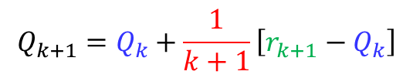
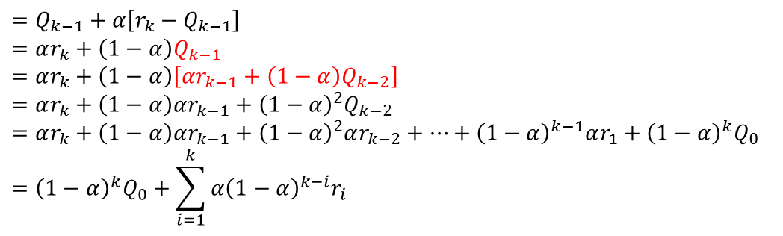


Step-size parameter and non-stationary
Incremental Update formula for action value
$$Q_{k+1}=Q_{k}+\frac{1}{k+1}\left[r_{k+1}−Q_{k}\right]$$
$$NewEstimate←OldEstimate+StepSize\left[Target−OldEstimate\right]$$
$$α_{k}$$
When the distribution of the reward is non-stationary, it is natural to weight recent rewards more heavily than long-past ones
One of the most popular ways of doing this is to use a constant step-size parameter
$$Q_{k+1}=Q_{k}+α\left[r_{k+1}−Q_{k}\right]$$
$$Q_{k}$$
$$=Q_{k−1}+α\left[r_{k}−Q_{k−1}\right]$$
$$=αr_{k}+{\left(1−α\right)Q}_{k−1}$$
$$=αr_{k}+\left(1−α\right)\left[αr_{k−1}+{\left(1−α\right)Q}_{k−2}\right]$$
$$=αr_{k}+\left(1−α\right)αr_{k−1}+{\left(1−α\right)}^{2}Q_{k−2}$$
$$=αr_{k}+\left(1−α\right)αr_{k−1}+{\left(1−α\right)}^{2}αr_{k−2}+⋯+{\left(1−α\right)}^{k−1}αr_{1}+{\left(1−α\right)}^{k}Q_{0}$$
$$={\left(1−α\right)}^{k}Q_{0}+\sum_{i=1}^{k}{{α\left(1−α\right)}^{k−i}r_{i}}$$
Reward ${α\left(1−α\right)}^{k−i}$ given to $i$th reward $r_{i}$ is smaller when $k−i$ is larger (i.e., older reward is weighted less)
The estimate of $Q_{k}$ varies more in response to the most recently receive rewards!

Slide 17
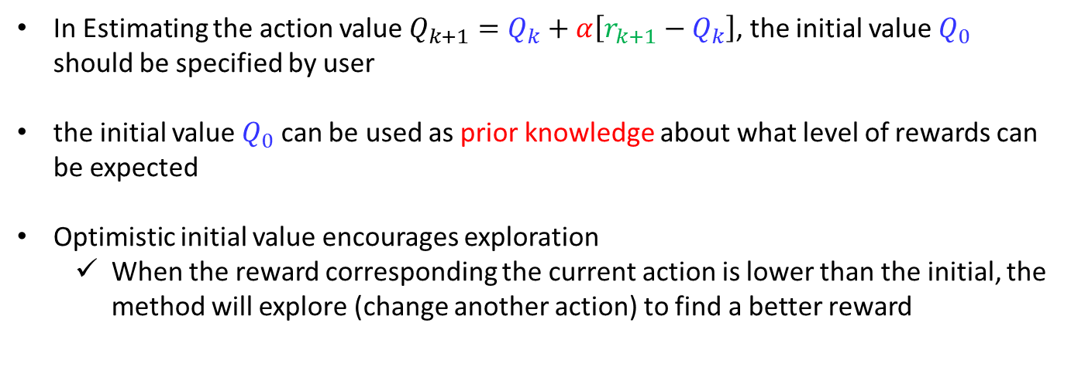
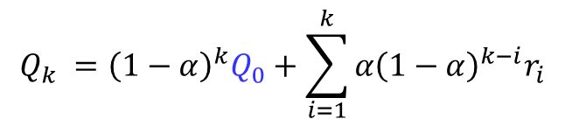
Optimistic Initial Values
In Estimating the action value $Q_{k+1}=Q_{k}+α\left[r_{k+1}−Q_{k}\right]$, the initial value $Q_{0}$ should be specified by user
the initial value $Q_{0}$ can be used as prior knowledge about what level of rewards can be expected
Optimistic initial value encourages exploration
When the reward corresponding the current action is lower than the initial, the method will explore (change another action) to find a better reward
$${Q_{k} =\left(1−α\right)}^{k}Q_{0}+\sum_{i=1}^{k}{{α\left(1−α\right)}^{k−i}r_{i}}$$

Slide 18
Reinforcement Comparison
Actions followed by large rewards should be made more likely to recur
Actions followed by small rewards should be made less likely to recur
How a learned to know what constitutes a large or small reward?
If an action is taken and the environment returns a reward of 5, Is it good or bad?
To make such a judgment one must compare the reward with some standard or reference level, called the reference reward.

Slide 19

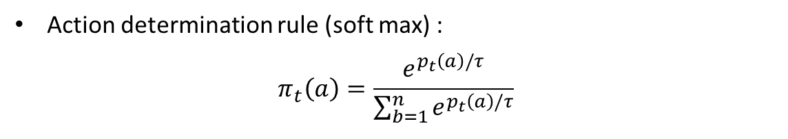
Reinforcement Comparison
Reinforcement Comparison algorithm
$p_{t}(a)$ : The preference for each action at time $t$ (not an actual action value)
Action determination rule (soft max) :
$$π_{t}\left(a\right)=\frac{e^{p_{t}\left(a\right)/τ}}{\sum_{b=1}^{n}{e^{p_{t}\left(a\right)/τ}}}$$
After selecting action and observing reward, the preference $p_{t}(a)$ is updated :
$p_{t+1}\left(a_{t}\right)=$ $p_{t}\left(a_{t}\right)+β\left[r_{t}−{\overline{r}}_{t}\right]$
High rewards should increase the probability of reselecting the action taken
$β$ is a positive step-size parameter
The reference reward ${\overline{r}}_{t}$ (i.e., average reward) is updated using all recently received rewards whichever actions were taken:
$${\overline{r}}_{t+1}={\overline{r}}_{t}+α\left[r_{t}−{\overline{r}}_{t}\right]$$
Reinforcement comparison method can be very effective sometimes outperforming $ε−greedy$ method

Slide 20
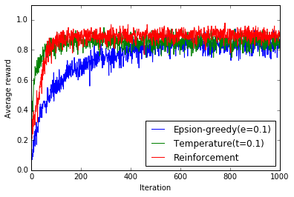
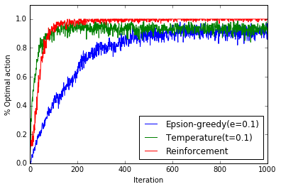
Reinforcement Comparison

Slide 21
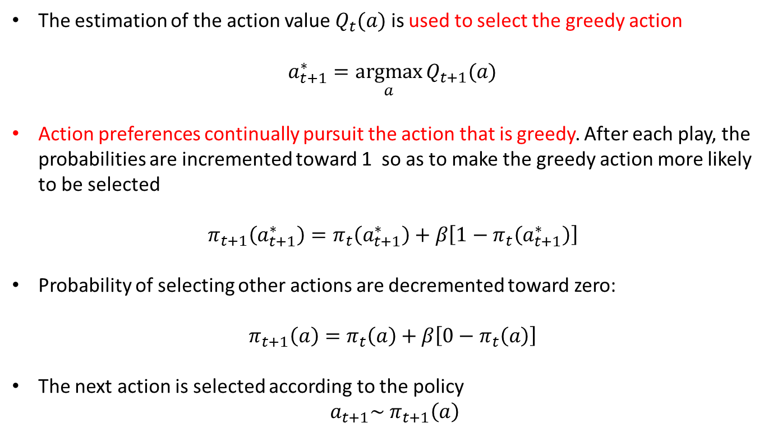
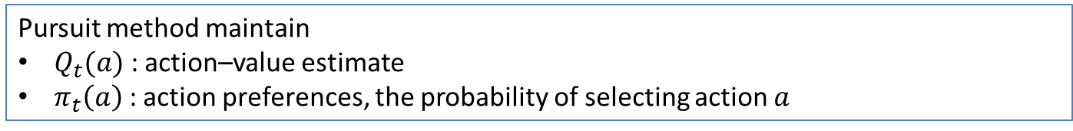
Pursuit Methods
Pursuit method maintain
$Q_{t}(a)$ : action–value estimate
$π_{t}\left(a\right)$ : action preferences, the probability of selecting action $a$
The estimation of the action value $Q_{t}(a)$ is used to select the greedy action
$a_{t+1}^{∗}=\underset{a}{argmax}{Q_{t+1}(a)}$
Action preferences continually pursuit the action that is greedy. After each play, the probabilities are incremented toward 1 so as to make the greedy action more likely to be selected
$$π_{t+1}\left(a_{t+1}^{∗}\right)=π_{t}\left(a_{t+1}^{∗}\right)+β\left[1−π_{t}\left(a_{t+1}^{∗}\right)\right]$$
Probability of selecting other actions are decremented toward zero:
$$π_{t+1}\left(a\right)=π_{t}\left(a\right)+β\left[0−π_{t}\left(a\right)\right]$$
The next action is selected according to the policy
${a_{t+1}\sim π}_{t+1}\left(a\right)$

Slide 22
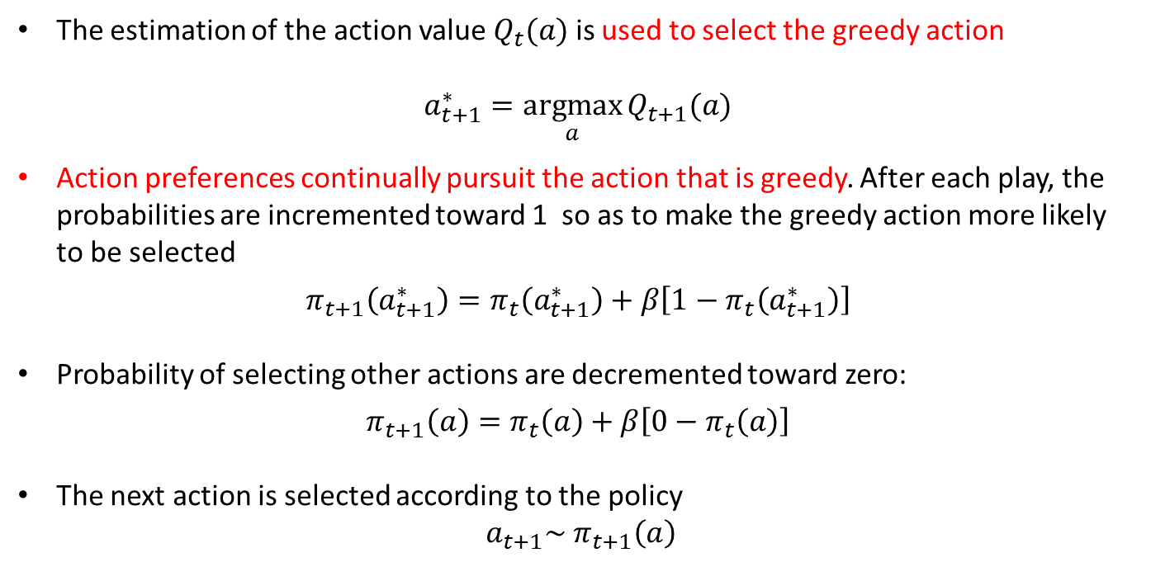
Pursuit Methods
Pursuit method maintain
$Q_{t}(a)$ : action–value estimate
$π_{t}\left(a\right)$ : action preferences, the probability of selecting action $a$
The estimation of the action value $Q_{t}(a)$ is used to select the greedy action
$a_{t+1}^{∗}=\underset{a}{argmax}{Q_{t+1}(a)}$
Action preferences continually pursuit the action that is greedy. After each play, the probabilities are incremented toward 1 so as to make the greedy action more likely to be selected
$$π_{t+1}\left(a_{t+1}^{∗}\right)=π_{t}\left(a_{t+1}^{∗}\right)+β\left[1−π_{t}\left(a_{t+1}^{∗}\right)\right]$$
Probability of selecting other actions are decremented toward zero:
$$π_{t+1}\left(a\right)=π_{t}\left(a\right)+β\left[0−π_{t}\left(a\right)\right]$$
The next action is selected according to the policy
${a_{t+1}\sim π}_{t+1}\left(a\right)$
$$Q_{t}\left(a\right)→π_{t}\left(a\right)→a_{t+1}+r_{t+1}→Q_{t+1}(a)$$

Slide 23
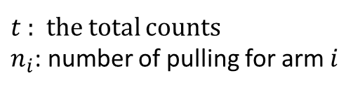

Upper Confidence Bound (UBC method)
Use confidence intervals, or some other measure of uncertainty, to encourage exploration of particular actions is sound and appealing
Upper Confidence Bound (Cesa-Bianchi and Fisher, 2002)
$$a_{t}=arg\max_{i}\left(μ_{i}+\sqrt{\frac{2lnt}{n_{i}}}\right)$$
$t$ : the total counts
$n_{i}$: number of pulling for arm $i$

Slide 24
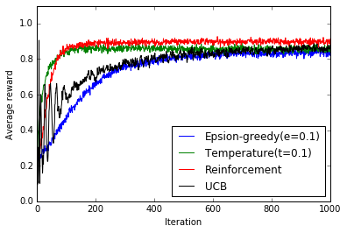
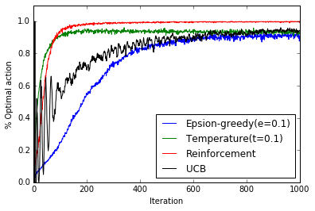
Upper Confidence Bound (UBC method)

Slide 25
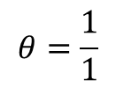

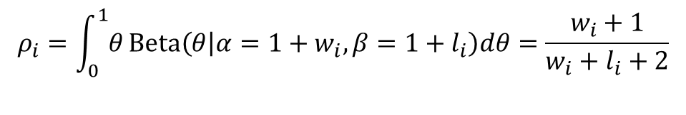






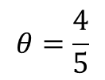

Bayesian View on Bandit Problem (MDP formulation)
The posterior of the success probability given $w_{t}$ winnings and $l_{t}$ loss :
$$θ_{t}|w_{t}, l_{t}\sim Beta(θ|α=1+w_{t}, β=1+l_{t})$$
The mean probability of success :
$$ρ_{i}=\int_{0}^{1}{θ}Beta\left(θ | α=1+w_{i}, β=1+l_{i}\right)dθ=\frac{w_{i}+1}{w_{i}+l_{i}+2}$$
data
MLE
Bayesian
$$p(θ)$$
$$w$$
$$θ=\frac{1}{1}$$
$$θ|data\sim Beta\left(2,1\right)$$
$$θ=\frac{4}{5}$$
$$θ|data\sim Beta\left(5,2\right)$$
$$w, w,w,l,w$$
$$0$$
$$θ$$
$$1$$

Slide 26
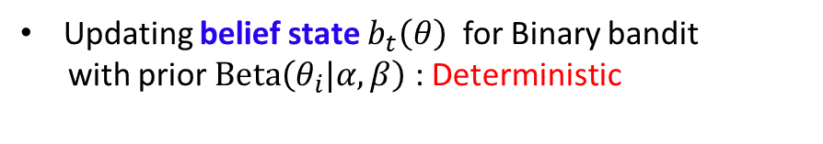






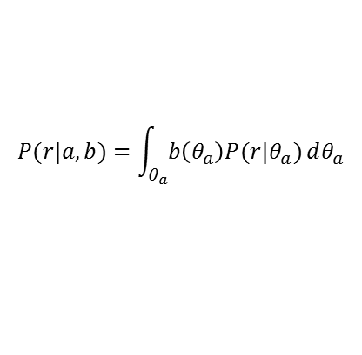


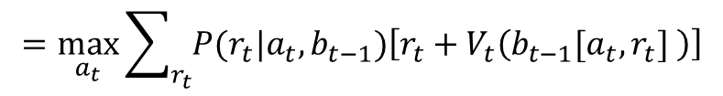

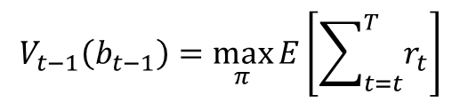
Bayesian View on Bandit Problem (MDP formulation)
MDP over belief state and finding optimal policy using Dynamic Programming
$h_{t}=\left[\left(a_{1},r_{1}\right), \left(a_{1},r_{1}\right),…, \left(a_{t},r_{t}\right)\right]$
$$A_{t−1}$$
$$A_{t}$$
$θ=\left(θ_{i},…,θ_{n}\right)$ : Unknown machine parameters
Belief state $b_{t}\left(θ\right)=$ $P\left(θ|h_{t}\right)$ : probability dist. on para.
$$R_{t−1}$$
$$R_{t}$$
Updating belief state $b_{t}\left(θ\right)$ for Binary bandit
with prior $Beta\left(θ_{i}|α,β\right)$ : Deterministic
$$b_{t}\left(θ_{i}\right)=b_{t−1}\left[a_{t},r_{t}\right]=Beta\left(θ_{i}|α+w_{t,i},β+l_{t,i}\right)$$
$$b_{t−1}$$
$$b_{t}$$
$w_{t,i}$: Accumulated wins with arm $i$ up to time $t$
$l_{t,i}$: Accumulated loses with arm $i$ up to time $t$
Dynamic programming on the value function
$$V_{t−1}\left(b_{t−1}\right)=\max_{π}{E\left[\sum_{t=t}^{T}{r_{t}}\right]}$$
$$=\max_{a_{t}}{\sum_{r_{t}}{P(r_{t}|a_{t},b_{t−1})\left[r_{t}+V_{t}\left(b_{t−1}[a_{t},r_{t}] \right)\right]}}$$
$$P(r|a,b)=\int_{θ_{a}}^{ }{b\left(θ_{a}\right)P(r|θ_{a})}dθ_{a}$$

Slide 27
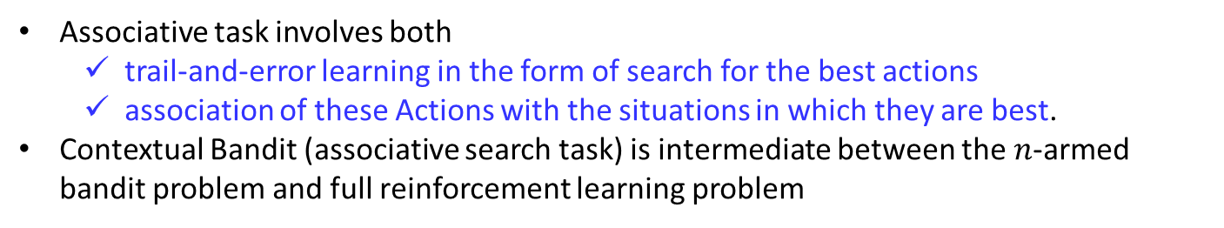
From Bandit to Reinforcement Learning
Model is unknown
No state dynamic
State dynamic
(action affect state transition and future reward)
Optimum
action
Single state
(non-associative)
Bandit
-
Optimum
policy
Multiple state
(associative)
Contextual Bandit
Reinforcement learning
Associative task involves both
trail-and-error learning in the form of search for the best actions
association of these Actions with the situations in which they are best.
Contextual Bandit (associative search task) is intermediate between the $n$-armed bandit problem and full reinforcement learning problem

Slide 28
Relationship with model based appraoch
Only
Exploitation
Exploration
vs
Exploitation
Model is known
Model is unknown
Single state
Optimization
Bandit
Optimum
action
Contextual Bandit
Optimum
policy
Multiple state
Dynamic
Programing
Reinforcement learning
We going to learn Dynamic Programming approach first, and move to Reinforcement learning

Slide 29
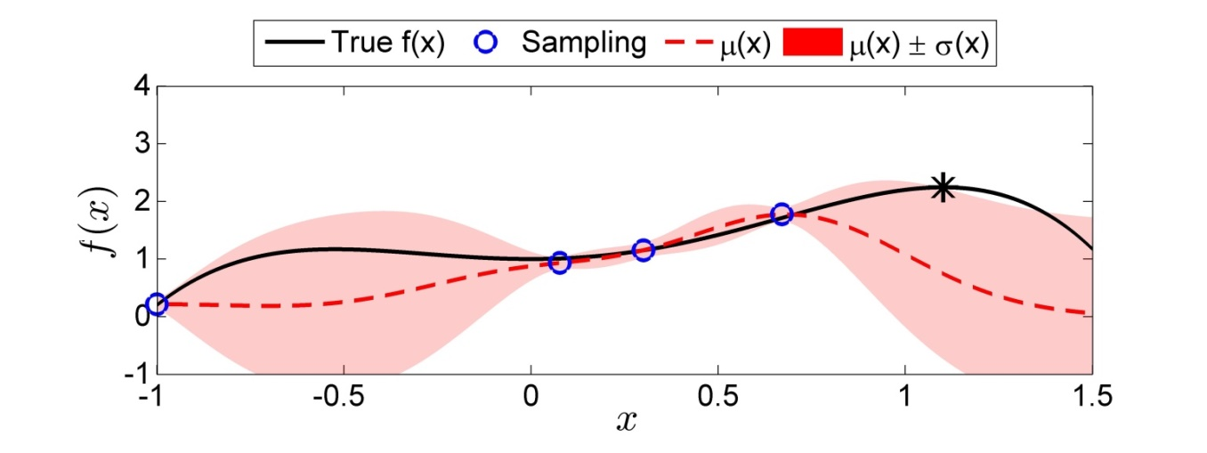
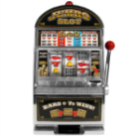
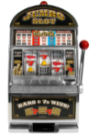
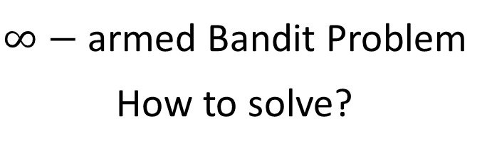

Next Lecture
$∞−$ armed Bandit Problem
How to solve?
Learn target function
(exploration)
Improve target value
(exploitation)
$$f$$
Which machine should be selected?

